Slide 1
Lecture 1-2
Introduction
Presented By:
Er. Shivani Thakur AP, CSE
Reference: Data communication and networking B.A. Forouzan, 4th Edition
1.<number>
Notes:
1.#

Slide 2
Contents
Data Communications
Networks
The Internet
Protocols and Standards
1.<number>
Notes:
1.#

Slide 3
1-1 DATA COMMUNICATIONS
The term telecommunication means communication at a distance. The word data refers to information presented in whatever form is agreed upon by the parties creating and using the data.
Data communications are the exchange of data between two devices via some form of transmission medium such as a wire cable.
1.<number>
Notes:
1.#

Slide 4
The effectiveness of a data communication system depends on four fundamental characteristics:
Delivery: Deliver data to the correct destination.
Accuracy: The system must deliver the data accurately.
Timeliness: The system must deliver data in a timely manner.
Jitter: Jitter refers to the variation in the packet arrival time.
Topics discussed in this section:
Components
Data Représentation
Data Flow
1.<number>

Slide 5

Figure 1.1 Five components of data communication
1.<number>
Notes:
1.#

Slide 6
Data Representation
Text- Sequence of bits 0’s, 1’s, ASCII code
Numbers- Bit patterns, ASCII code
Images- Matrix of pixels in RGB or YCM color format
Audio- Continuous signal generated from microphone etc.
Video- Continuous or combination of images
Animation- Combination of images
1.<number>
Notes:
1.#

Slide 7

Figure 1.2 Data flow
Three modes:
Simplex: Unidirectional data, send or receive only one operation.
Example: Printer
Half-duplex: Bidirectional, Send and receive, one at a time.
Example: walky-talky
Full-duplex: Bidirectional, send and receive, both at a time.
Example: Telephone communication
1.<number>
Notes:
1.#

Slide 8
1-2 NETWORKS
A network is a set of devices (often referred to as nodes) connected by communication links. A node can be a computer, printer, or any other device capable of sending and/or receiving data generated by other nodes on the network.
Topics discussed in this section:
Distributed Processing
Network Criteria
Physical Structures
Network Models
Categories of Networks
Interconnection of Networks: Internetwork
1.<number>
Notes:
1.#

Slide 9
Distributed Processing: Task is divided among multiple computers.
Network Criteria: Performance, Reliability, Security
Performance: Measured by: transit time (amount of time required for a message to travel from one device to another.)
response time (elapsed time between an inquiry and a response).
Performance: Depends upon: Number of users,
Type of transmission medium, Capabilities of the connected hardware, The efficiency of the software
Performance: Evaluated using: Throughput is the number of messages successfully delivered per unit time. Delay is the latency in data communication.
1.<number>
Notes:
1.#

Slide 10
Reliability : Is measured by the frequency of failure,
The time it takes a link to recover from a failure,
The network's robustness in a catastrophe.
Security: Protecting data from unauthorized access,
Protecting data from damage and development,
Implementing policies and procedures for recovery from breaches and data losses.
Physical Structures: Type of connection
Physical topology
Type of connection: Point –to-point (TV and remote)
Multipoint (Hotspot, Hub)
Physical topology: Mesh
Star
Bus
Ring
Hybrid
1.<number>

Slide 11

Figure 1.3 Types of connections: point-to-point and multipoint
1.<number>
Notes:
1.#

Slide 12

Figure 1.4 Categories of topology
1.<number>
Notes:
1.#

Slide 13

Figure 1.5 A fully connected mesh topology (five devices)
Mesh Topology
Dedicated point to point link between each device.
In n node system each node is connected to n-1 nodes.
Number of physical links required n(n-1).
Duplex communication between each node.
Number of I/O ports per device required are n-1.
1.<number>
Notes:
1.#

Slide 14
Advantages: No traffic problem.
Robust, if one link fails doesn’t effect entire system.
Privacy and security due to dedicated link.
Fault detection easy due to pint to pint link.
Disadvantages: Amount of cabling required is very high.
Wiring bulk can be greater than available space.
Expensive hardware.
Example: Telephone regional office.
1.<number>

Slide 15

Figure 1.6 A star topology connecting four stations
Dedicated point to point link only to central controller (hub).
No direct connection/traffic between devices.
Controller act as exchange: data is send/receive through controller.
Every device needs one I/O port for connection except central hub (n ports for n devices).
1.<number>
Notes:
1.#

Slide 16
Advantages: Less expensive than mesh.
Each device needs one link and one I/O port.
Easy to install and reconfigure.
Less cabling is required.
Robust, if one link fails then whole network doesn’t effected.
Easy fault detection and isolation.
Disadvantages: Dependency of whole topology on a single point, hub.
If hub goes down, whole system goes down.
Example: LAN.
1.<number>

Slide 17

Figure 1.7 A bus topology connecting three stations
Multipoint Connection.
A long backbone cable is used to link all devices in the network.
Nodes are connected to bus cables by drop line and tapping.
A connector slices or punctures the backbone cable to make connection.
With transmission energy of a signal gets converted to heat so signal becomes weaker so limited taps can be made.
1.<number>
Notes:
1.#

Slide 18
Advantages: Each device needs one link and one I/O port.
Easy to install.
Less cabling is required than mesh and star.
Disadvantages: Difficult reconnection and fault isolation.
Difficult to add new devices.
Signal reflection ag taps degrades the quality.(More space b/w taps is required)
Fault in bus breaks all connection, even in same side of breaking point.
Damaged area sends signals back to the origin and therefore creation of noise.
Example: Early LANs.
1.<number>

Slide 19

Figure 1.8 A ring topology connecting six stations
Point to point connection among each device with two devices on either side of a device.
Signal travels from one device to another in one direction along ring till reaches destination.
Each device carries a repeater which regenerates the bits and pass to next device if not meant for it.
Two links per device are required.
1.<number>
Notes:
1.#

Slide 20
Advantages: Easy to install and reconfigure.
To add or remove a device only two connections are altered.
Less cabling is required than mesh and star.
Fault isolation is easy as device issues an alarm if not receives a signal from previous device.
Disadvantages: Unidirectional Traffic.
Break in ring can disable entire network. (Dual ring as a solutio
Example: IBM token ring.
1.<number>

Slide 21

Figure 1.9 A hybrid topology: a star backbone with three bus networks
Combination of more than one topologies.
1.<number>
Notes:
1.#

Slide 22
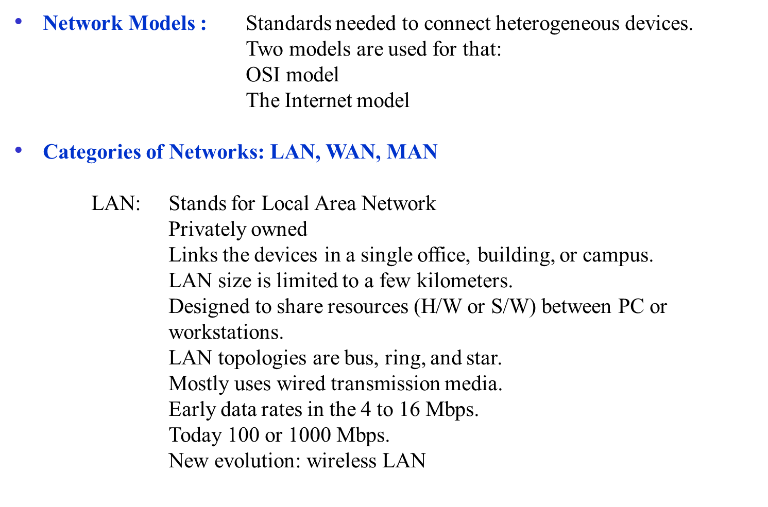
1.<number>

Slide 23

Figure 1.10 An isolated LAN connecting 12 computers to a hub in a closet
1.<number>
Notes:
1.#

Slide 24
WAN: Stands for Wide Area Network.
Provides long-distance transmission of data, image, audio,
and video information over large geographic areas that may comprise a country, a continent, or even the whole world.
Types: Switched (connects the end systems, X.25, ATM) or
Point-to-point (a line connects home pc or LAN to ISP)
Data rates 100Mbps or more.
MAN: Stands for metropolitan area network.
Size between a LAN and a WAN.
Covers the area inside a town or a city.
Designed for customers who need a high-speed connectivity.
Cable TV, DSL.
10Mbps to 1Gbps.
1.<number>

Slide 25

Figure 1.11 WANs: a switched WAN and a point-to-point WAN
1.<number>
Notes:
1.#

Slide 26

Figure 1.12 A heterogeneous network made of four WANs and two LANs
Interconnection of Networks:
Internetwork: When two or more networks are connected, they become an internetwork, or internet
1.<number>
Notes:
1.#

Slide 27
1-3 THE INTERNET
The Internet is a communication system that has brought a wealth of information to our fingertips and organized it for our use. An internet (lowercase letter i) is two or more networks that can communicate with each other. Internet (uppercase letter I), a collaboration of more than hundreds of thousands of interconnected networks.
Topics discussed in this section:
A Brief History
The Internet Today (ISPs)
1.<number>
Notes:
1.#

Slide 28
A Brief History: Came into being in 1969.
In 1967, at an Association for Computing Machinery (ACM) meeting, ARPA presented its ideas for (Advanced Research Projects Agency) ARPANET, a small network of connected computers.
The idea was that each host computer would be attached to a specialized computer, called an interface message processor (IMP).
The IMPs, in tum, would be connected to one another.
By 1969, ARPANET was a reality.
Four nodes, at the University of California at Los Angeles (UCLA), the University of California at Santa Barbara (UCSB), Stanford Research Institute (SRI), and the University of Utah, were connected via the IMPs to
form a network.
Software called the Network Control Protocol (NCP) provided communication between the hosts.
In 1972, Vint Cerf and Bob Kahn part of ARPANET collaborated on what they called the Internetting Project.
1973 paper they outlined the protocols to achieve end-to-end delivery of packets on TCP This included concepts such as encapsulation, the datagram, and the functions of a gateway.
TCP divided into two protocols: TCP and IP
IP would handle datagram routing and TCP segmentation, reassembly, and error detection.
1.<number>

Slide 29
The Internet Today (ISPs):
End users who want Internet connection use the services of
Internet service providers (lSPs).
SPs are: International, National, Regional and Local Service Providers.
International ISP:Top of hierarchy connects nation together. E.g. Hibernia netwroks, Cogent Communications.
National ISPs: Backbone networks created and maintained by specialized companies. Reliance, Airtel, Vodafone etc.
These backbone networks are connected by complex switching stations (normally run by a third party) called network access points (NAPs) or peering points.
Operate up to speed of 600 Mbps.
Regional ISPs: Connected to national ISPs. Works at lower data rate.
Local ISPs: Connected to regional or National ISPs.
Provide service to end users connected to local ISPs.
1.<number>

Slide 30

Figure 1.13 Hierarchical organization of the Internet
1.<number>
Notes:
1.#

Slide 31
1-4 PROTOCOLS AND STANDARDS
In this section, we define two widely used terms: protocols and standards. First, we define protocol, which is synonymous with rule. Then we discuss standards, which are agreed-upon rules.
Topics discussed in this section:
Protocols
Standards
Standards Organizations
Internet Standards
1.<number>
Notes:
1.#

Slide 32
Protocols : A protocol is a set of rules that govern data communications.
A protocol defines:
what is communicated,
how it is communicated,
and when it is communicated.
The key elements of a protocol are: syntax, semantics, and timing.
Syntax: Refers to the structure or format of the data, meaning the ordering which they are presented. E.g. first 8 bits address of sender etc.
Semantics: Meaning of individual bit or action taken on individual bit. E.g. whether to consider 8 bits as destination address or address of route.
Timing: Refers two things: When the data to be sent and how fast it can be sent. E.g. sender sent 100mbps and receiver process 10mbps data, then data will be lost.
1.<number>

Slide 33
Standards: Are essential in creating and maintaining an open and competitive market for equipment manufacturers and in guaranteeing national and international interoperability of data and telecommunications technology and processes.
Standards Category: De facto: Not approved by an organized body, but became
standards because of its widespread use. Or standardized by the manufacturer who introduces new product.
De jure: Standards that have been legislated by an officially recognized body.
Standards Organizations: International Organization for Standardization (ISO)
International Telecommunication Union Telecommunication Standards (ITU-T)
American National Standards Institute(ANSI)
Institute of Electrical and Electronics Engineers (IEEE)
Electronic Industries Association(EIA)
Internet Standards: An Internet standard is a thoroughly tested specification that is useful to and adhered to by those who work with the Internet.
1.<number>

